Slide 1
Projected Impacts of Climate Change on SW Colorado Forests
A Practical Management Strategy
Jim Worrall
Suzanne Marchetti
US Forest Service Rocky Mountain Region Gunnison, Colorado
Jerry Rehfeldt
Nick Crookston
US Forest Service Rocky Mtn. Res. Station Moscow, Idaho

Slide 2
Outline
Climate change and recent forest disturbance
Bioclimate models
Strategy for applying models to forest management
Southwest Colorado Bioclimate Project

Slide 3
Need for considering climate change
We all know it is a looming problem that should be considered in forest management
Agency policies
Rate of change far faster than capacity of ecosystems to adjust
Degradation of watersheds, wildlife habitat, biodiversity, carbon storage, recreation, wood products
If you don’t plan for the future, you’re planning for the past
Notes:
We know climate change is a looming problem and needs to be considered in forest management
Policies direct incorporation of climate change into planning
If you don’t plan for the future, you’re planning for the past
Rate of change far faster than capacity of ecosystems to adjust
Degradation of watersheds, wildlife habitat, biodiversity, carbon storage, recreation, wood products

Slide 4
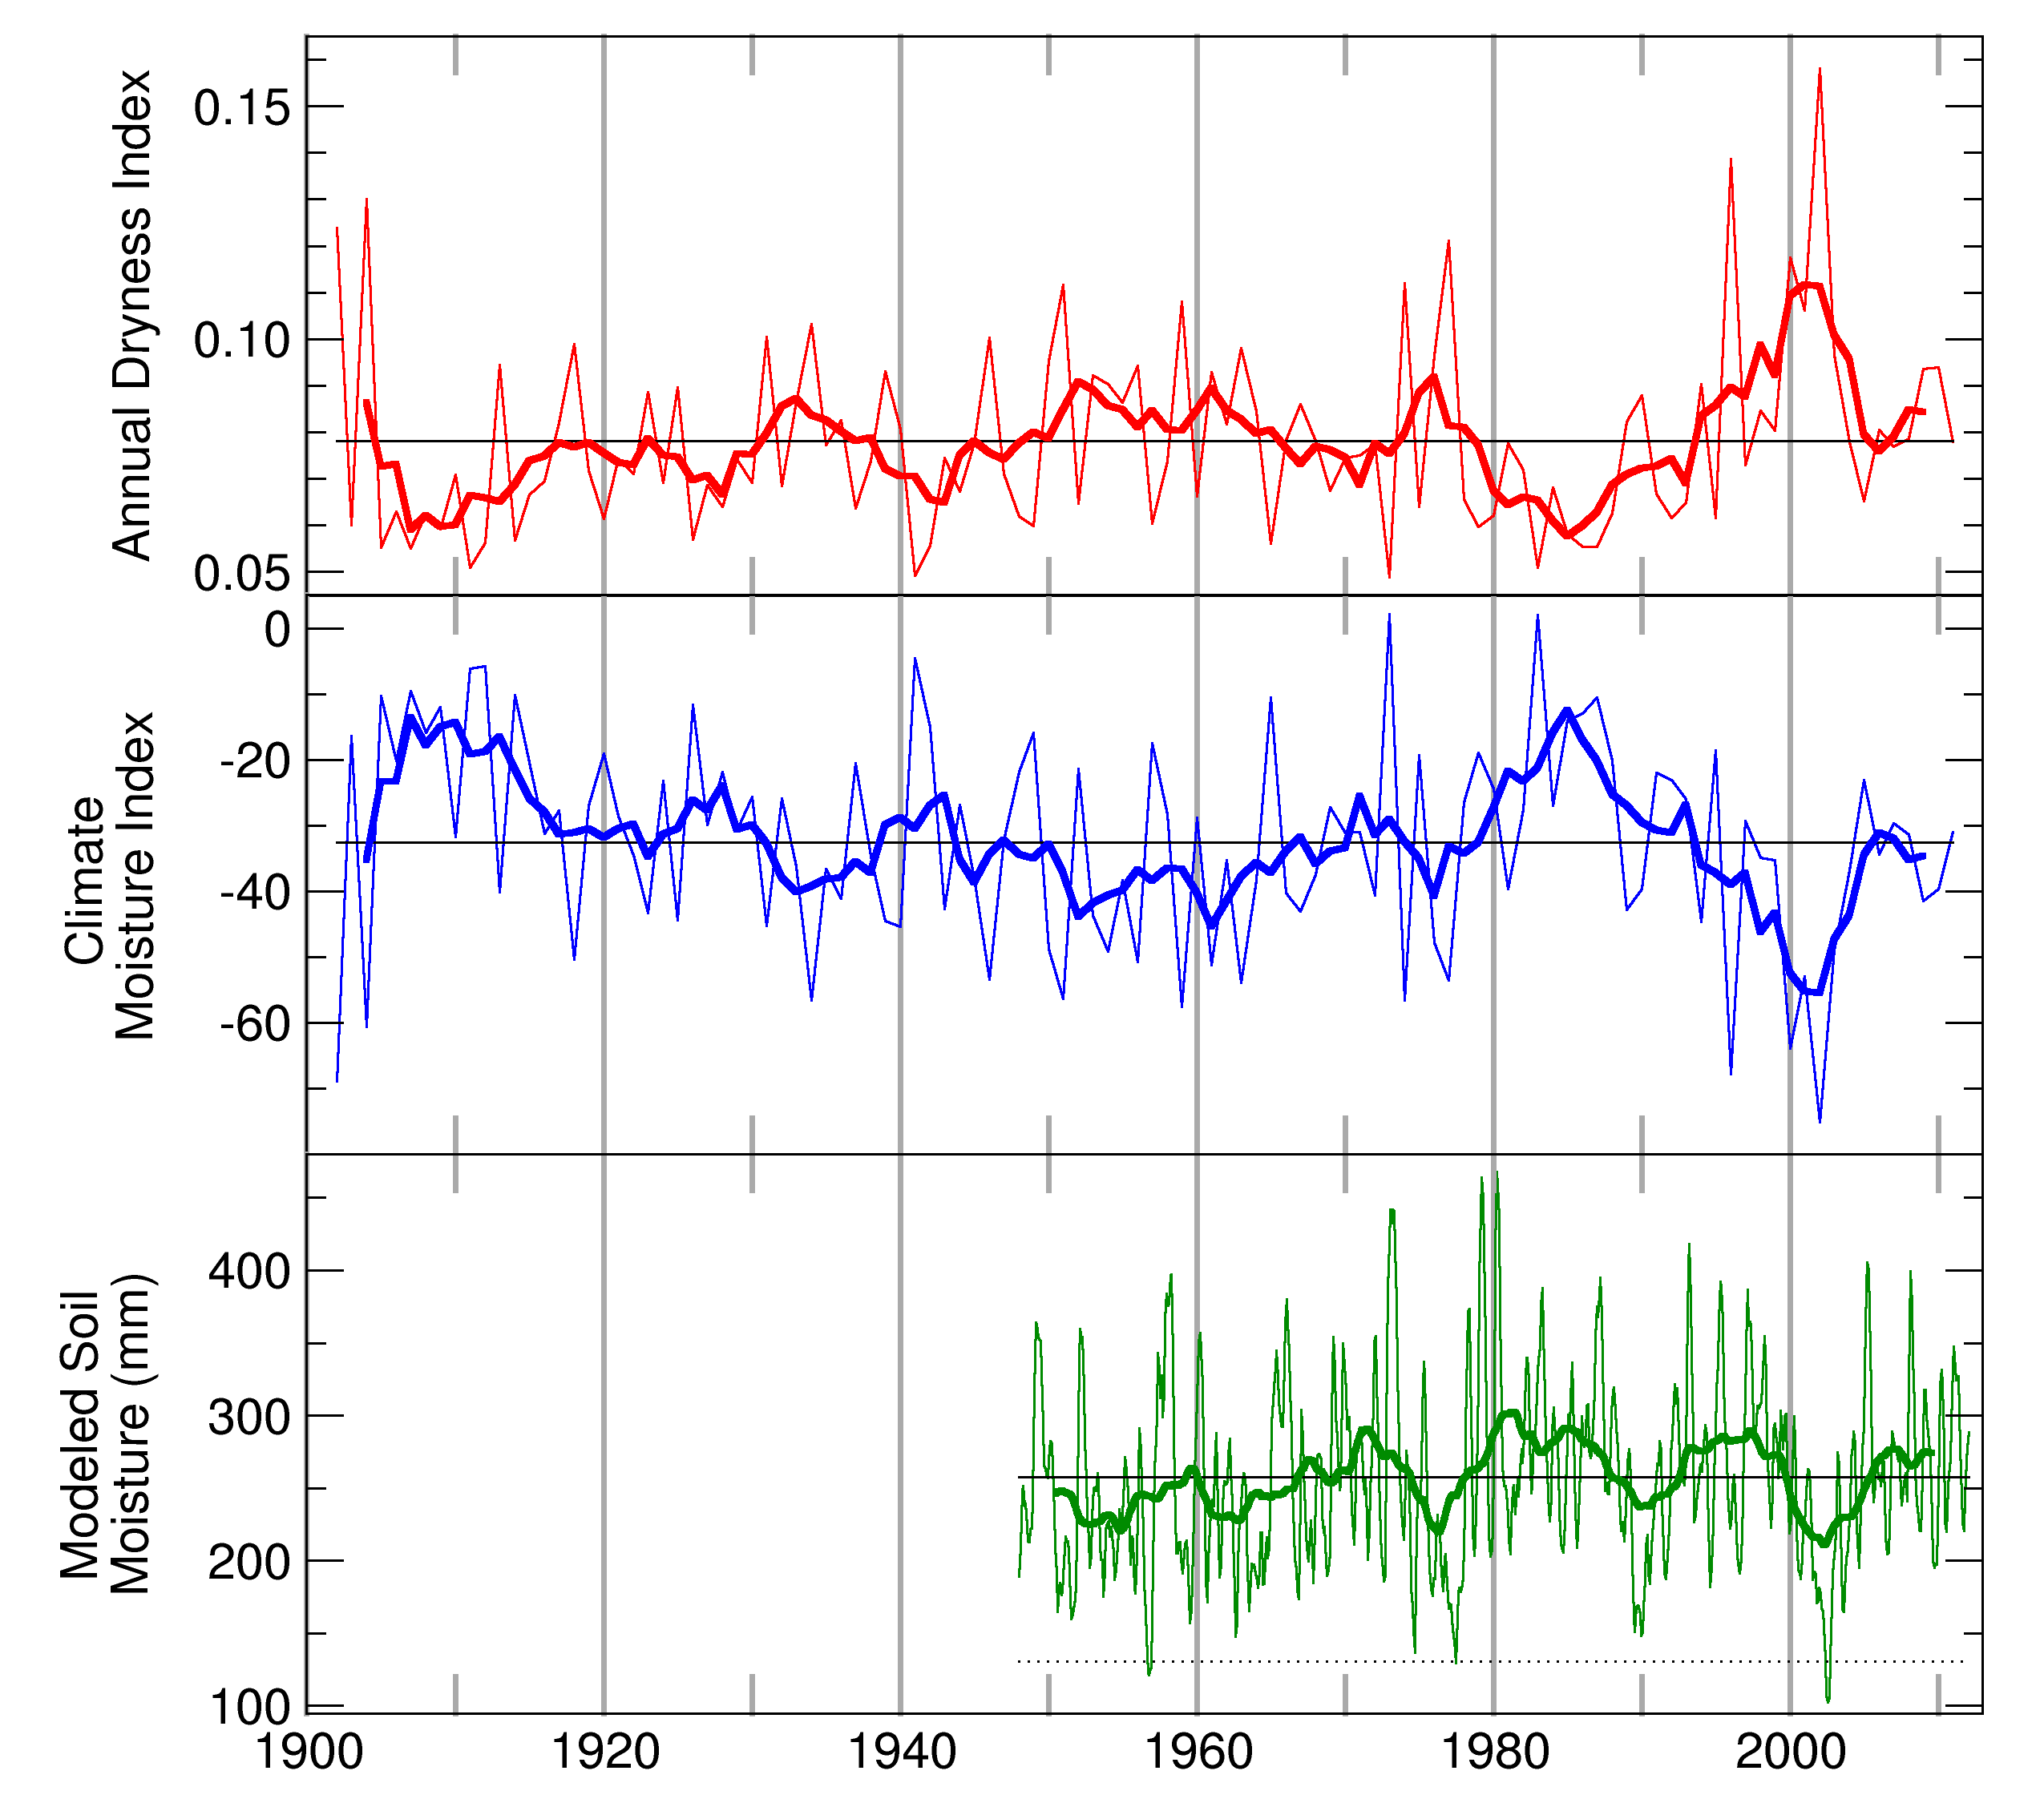
Turn-of-the-century drought
Record drought 2001-2003
Drying trend since mid ‘80s
Southern Colorado

Slide 5
Schwalm et al. 2012 Nature Geosciences
The turn-of-the-century drought in the context of the past
Conclusion: Most recent drought that severe occurred >800 yr ago.

Slide 6
Schwalm et al. 2012 Nature Geosciences
The turn-of-the-century drought in the context of the future
Sudden aspen decline
Massive mortality of piñon
Mountain pine beetle in northern Colorado
Spruce beetle
Most acres burned in CO (2002)
Summer precip. (June-Aug.)
CMIP5 ensemble
1900-2005: historical expt.
2006-2100: RCP 8.5
By the 2030’s, moisture conditions during the turn-of-the-century drought “. . . will become the new norm in western North America.”
“Towards the latter half of the twenty-first century the precipitation regime associated with the turn of the century drought will represent an outlier of extreme wetness”
Notes:
The turn-of-the-century drought had a spectacular impact on forests of the southern Rocky Mountains. It led to the huge mortality event in pinyon pine, to sudden aspen decline, the big mountain pine beetle outbreak in lodgepole pine up north, and probably played some role in getting the spruce beetle going too. So just imagine what things will look like in the latter part of this century.
Methods from Schwalm et al.: “Precipitation for 1900-2100 was taken from the CMIP5 multimodel
ensemble. The 1900-2005 values were based on the historical experiment whereas
2006-2100 values were taken from the RCP8.5 (Representative Concentration
Pathways) scenario. We aggregated monthly to peak growing season values
(June-August) and then used a five-year mean value to quantify the severity of the
turn of the century drought.”

Slide 7
Problem
We need to take the potential impacts of climate change into account while planning
But how do we know what those impacts will be?

Slide 8
Bioclimate Models
Background

Slide 9
Bioclimate models - what
Characterize climate suitable for a species
Climate is paramount in determining species presence
Input: climate variables, slope and aspect
Output: climatic suitability of the location for the species

Slide 10
Bioclimate models - how
Training data
Many points of known presence/absence
Mostly spatial veg data like FSVeg and FIA plots
Long-term historical climate at each point
Use reference climate 1961-1990
Also use slope and aspect
“Random forests” algorithm in R
“forests” of many decision “trees”, using random subsets of training data

Slide 11
Bioclimate models - how
Make it spatial
Instead of inputting a single set of climate variables, input grids of variables
Model votes on suitability for each gridpoint
Construct a grid of votes → map

Slide 12
Engelmann spruce
Notes:
Black is actual presence/absence of spruce based on vegetation databases.
Blue is the model prediction using reference climate.
Dark blue is where they overlap, correct prediction
Very little light blue and black inside forest – a remarkably good representation of distribution using only climate and aspect!

Slide 13
Process for projecting models into the future
3 GCMs x 3 RCPs → 9 climates → downscaled →
bioclimate models
→
Global climate models used by IPCC:
CCSM4
GFDLCM3
HadGEM2ES
9 outputs
→
Greenhouse-gas scenarios
4.6
6.0
8.5
votes
averaged

Slide 14
A strategy
Applying bioclimate models to forest management

Slide 15
Overview
Use difference in model output between reference and future periods to classify change zones
Model output (“votes”) are 0 (no chance) to 1 (very likely)
Develop management tactics and apply them to change zones where they have the greatest likelihood of success.
Change classes | Reference period | 2056-2065
Lost | ≥ 0.5 | < 0.3
Threatened | ≥ 0.5 | 0.3-0.5
Persistent | ≥ 0.5 | ≥ 0.5
Emergent | < 0.5 | ≥ 0.5

Slide 16
Aspen

Slide 17
Aspen

Slide 18
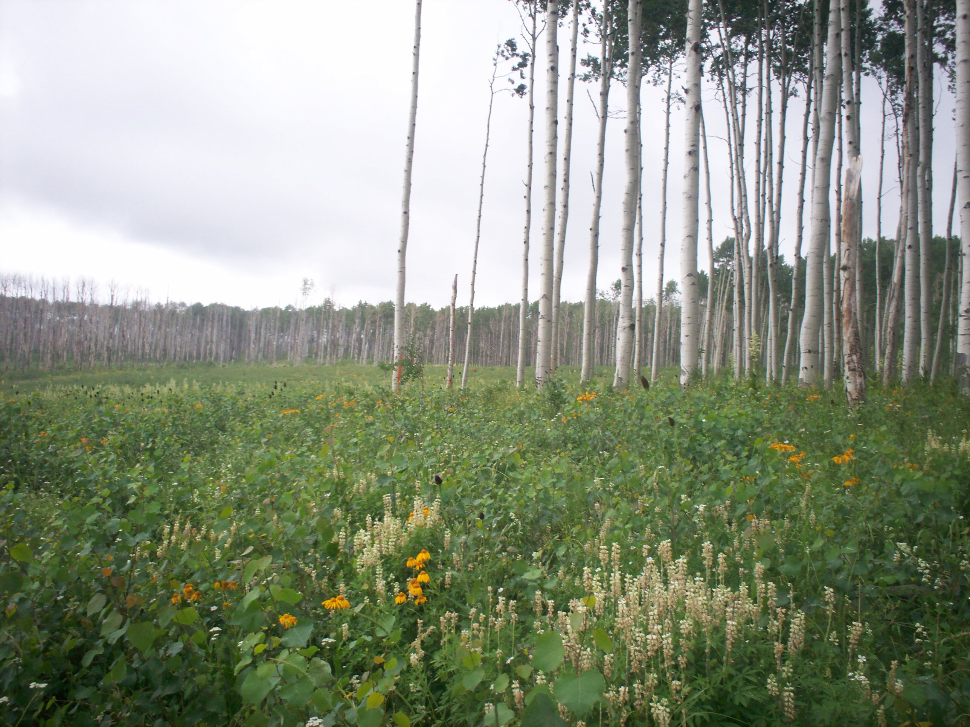
What do we do?
Using mechanical disturbance or fire:
Resilience: Regenerate mature aspen. Younger aspen is more resilient to extreme drought. This can be done in mixed stands.
Recovery: Regenerate SAD-affected stands before canopy loss is too high to avoid losing them

Slide 19
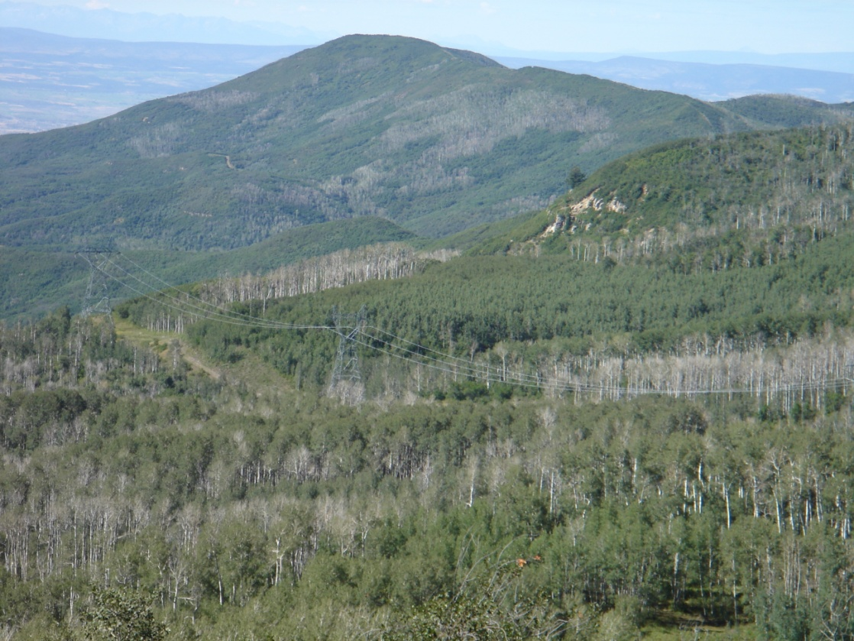
The Resilience of Youth
10-acre patch cut 1984
Healthy regeneration surrounded by dead and dying unmanaged aspen
Age <40 unaffected
Age diversity enhanced resilience to SAD
Notes:
OK, so what do we do with that map. Before getting into that, I want to give you some information on aspen treatments and what they can accomplish.

Slide 20
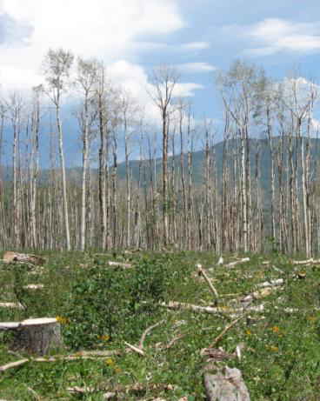
Can cutting bring it back? - CO
Wayne Shepperd & Skip Smith

Slide 21
Where do we do it?
Lost zone
In general, do not invest in resilience/recovery treatments. Treat only for short-term benefits or type change.
Threatened zone
Focus resilience and recovery treatments here to increase likelihood of aspen survival.
Persistent zone
Normal management, resilience, recovery. Favor existing aspen near Emergent zone.
Emergent zone
Consider disturbance treatments to facilitate migration.

Slide 22
Emergent
Facilitating Migration
Promote existing aspen near newly suitable areas to enhance seeding potential
Favor disturbances (esp. fire) in newly suitable areas to facilitate aspen establishment
Persistent

Slide 23
Engelmann spruce

Slide 24
Southwestern Colorado Bioclimate Project

Slide 25
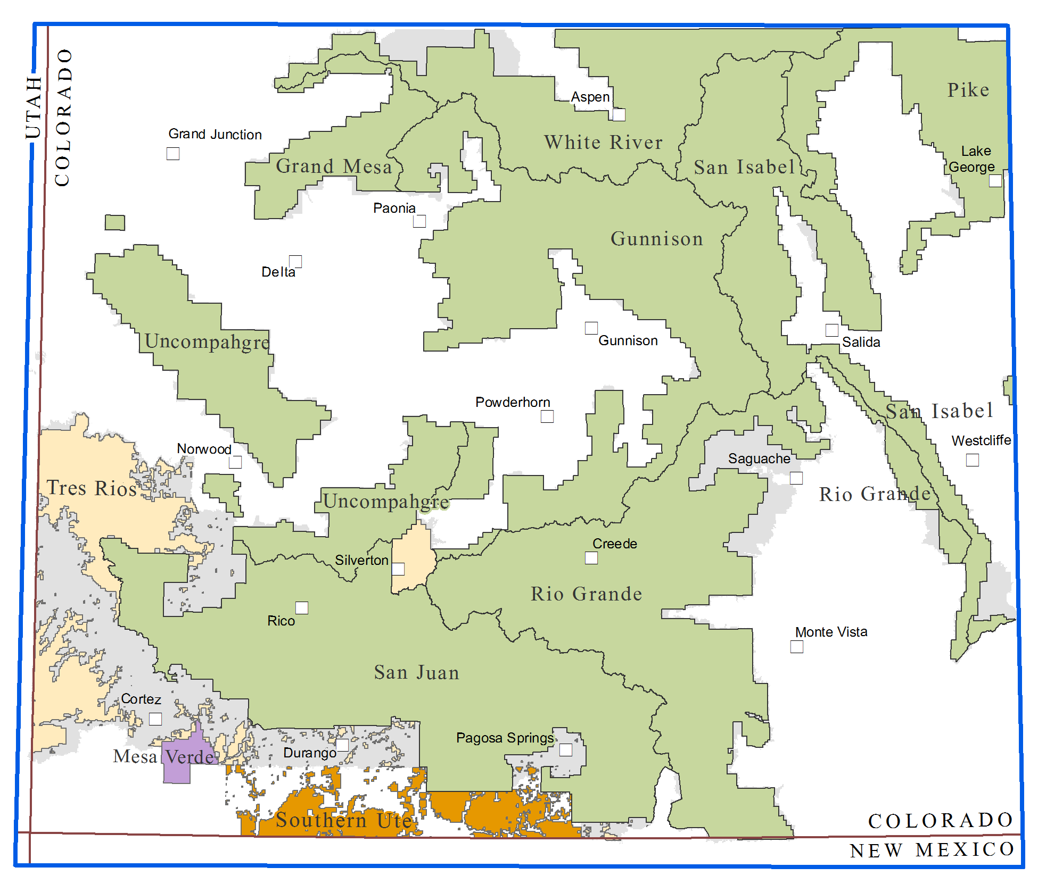

Slide 26
Plan
Partners provide spatial vegetation data
We develop bioclimate models
Project change zones
Research silviculturist develops adaptation recommendations for each unit
Workshop to share and discuss with partners
Training for other units to develop bioclimate models
Species:
White fir
Subalpine fir
Bristlecone pine
Limber pine
Ponderosa pine
Engelmann spruce
Blue spruce
Douglas-fir
Rocky Mtn. juniper
Utah juniper
Piñon
Gambel oak

Slide 27
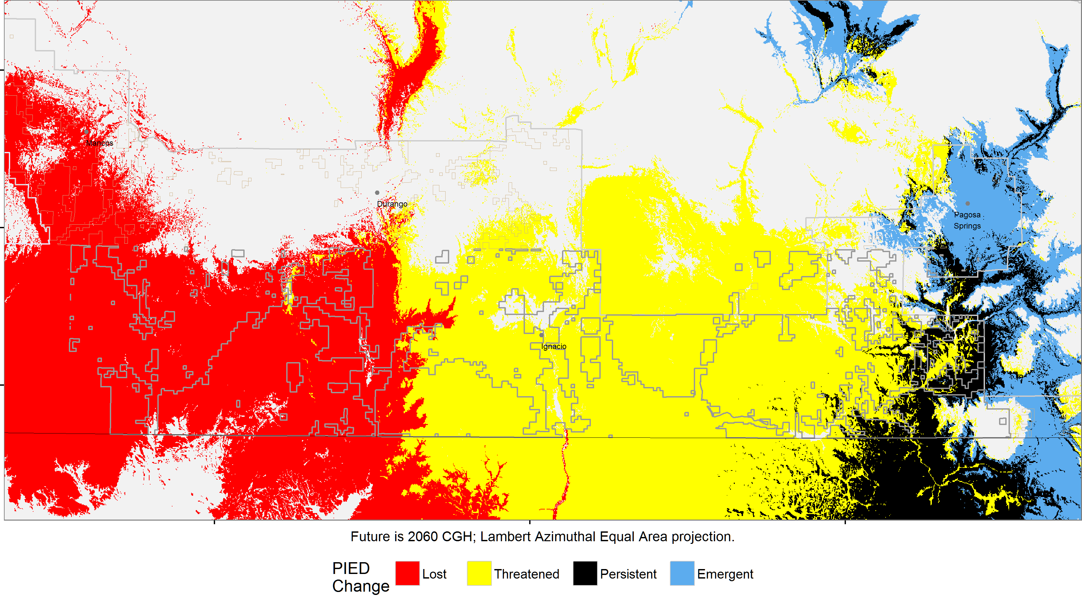
Piñon in Southern Ute area

Slide 28
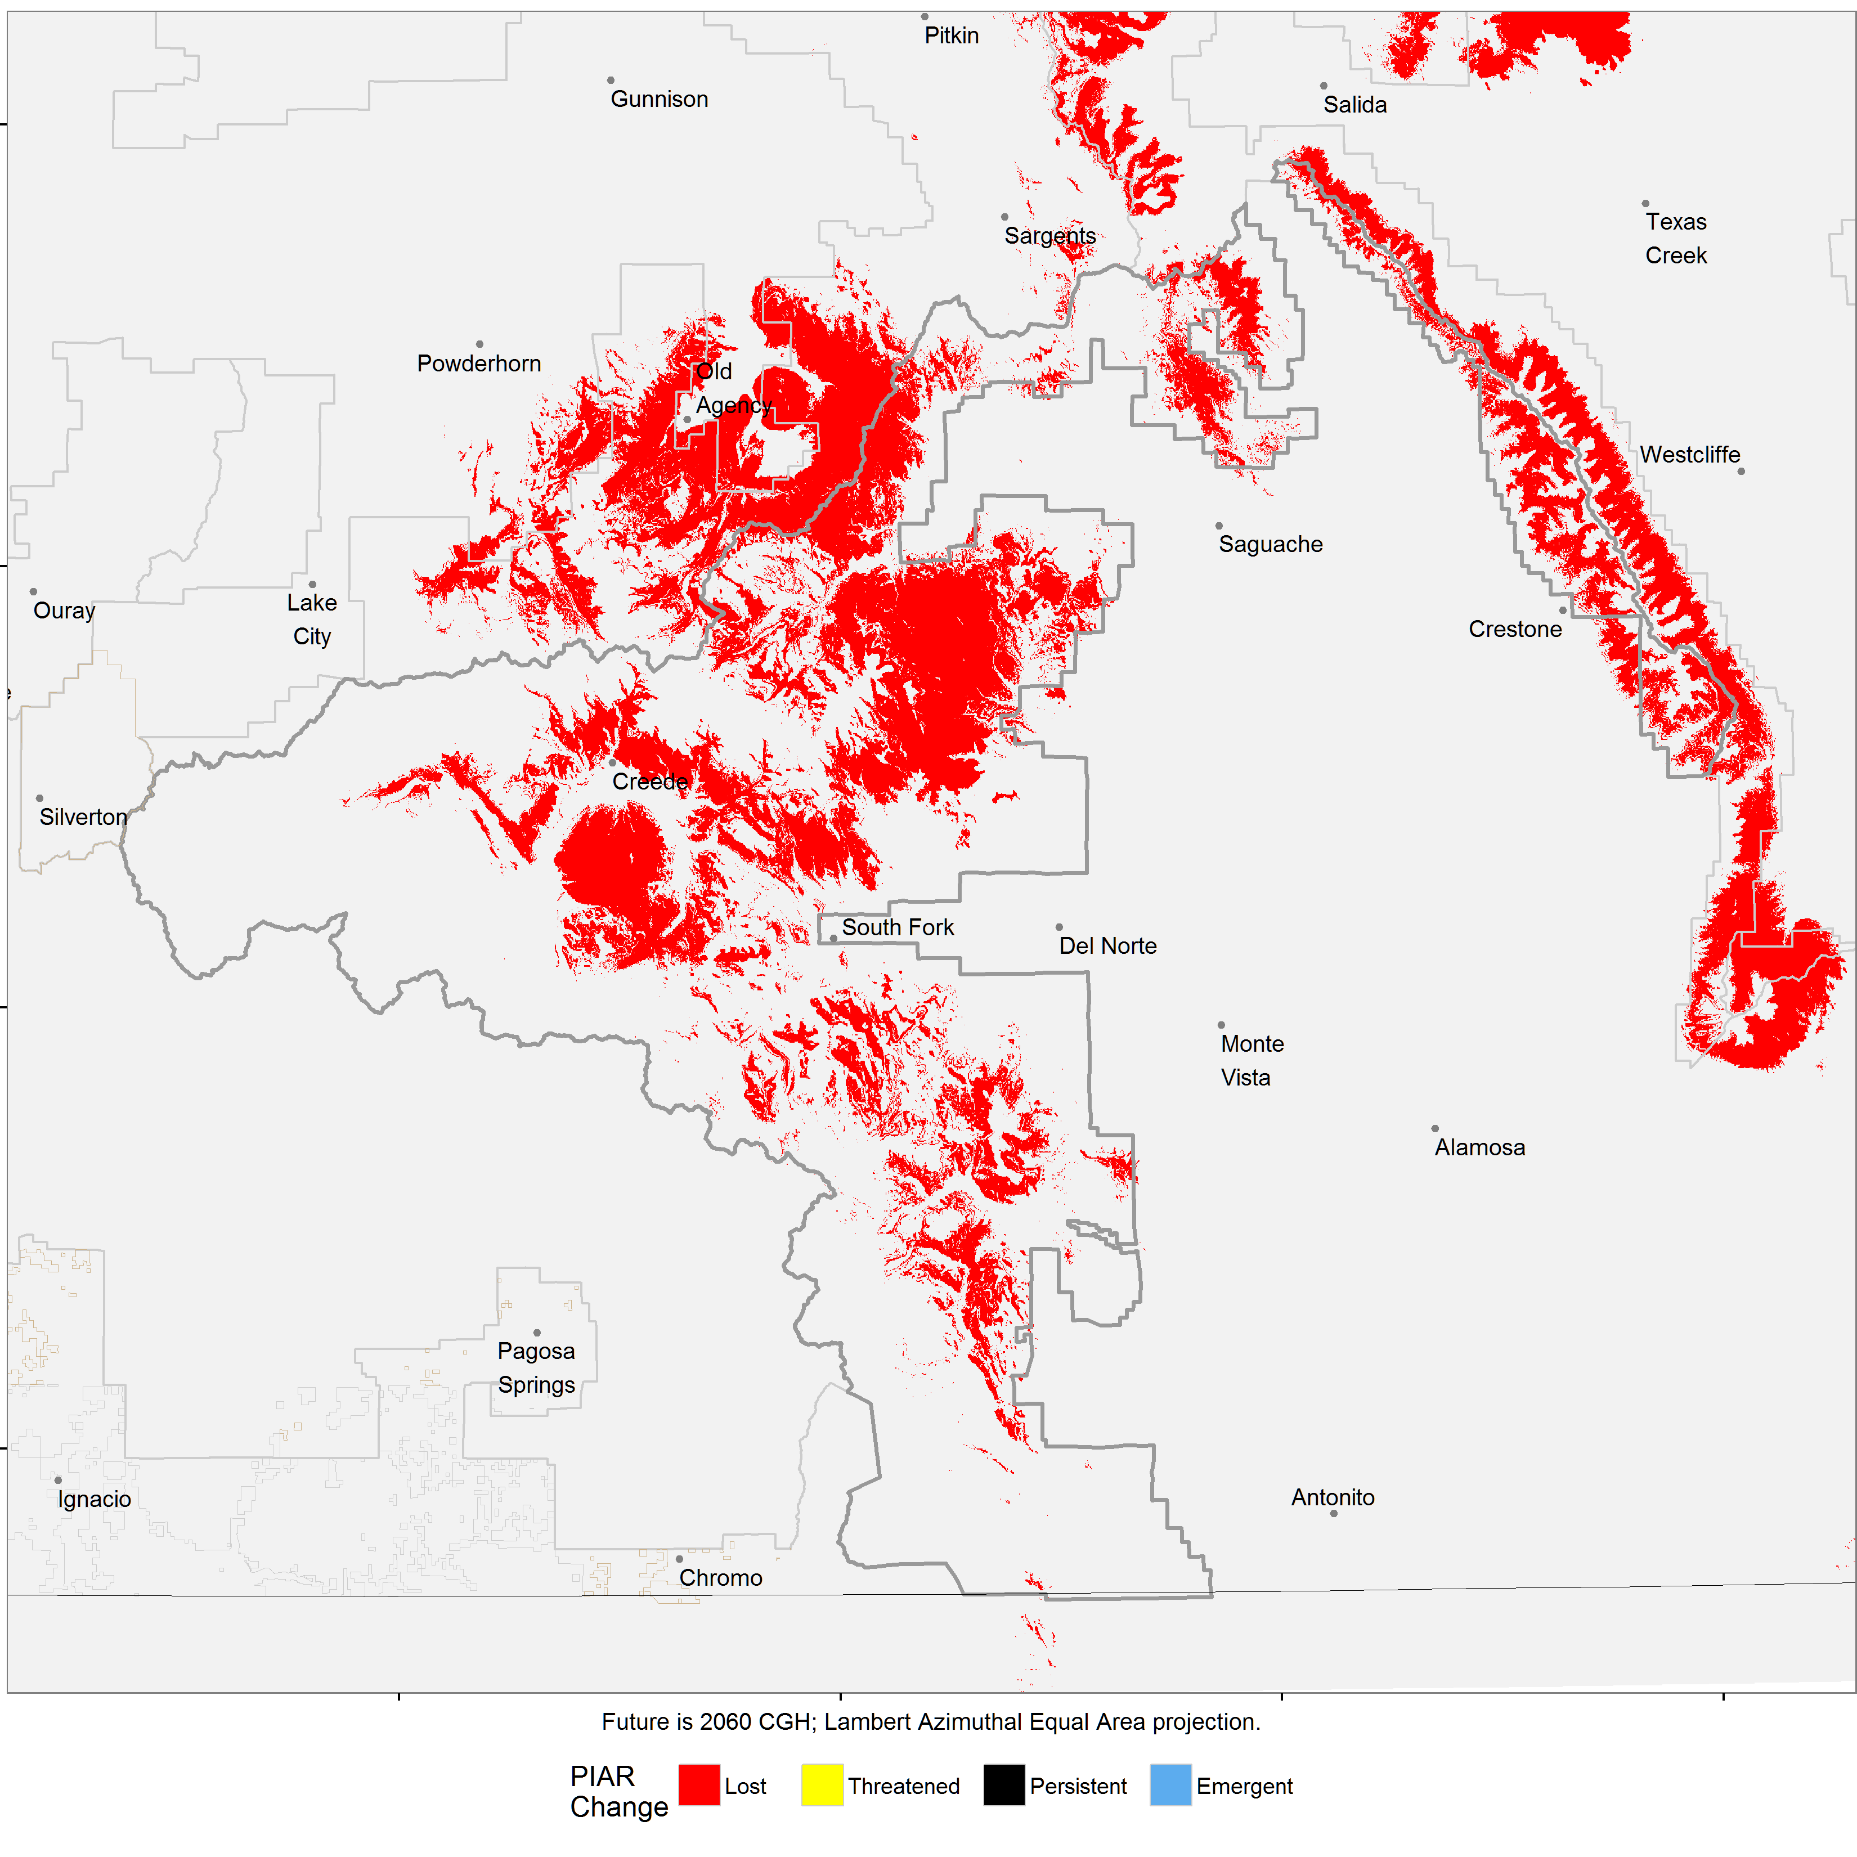
Bristlecone pine

Slide 29
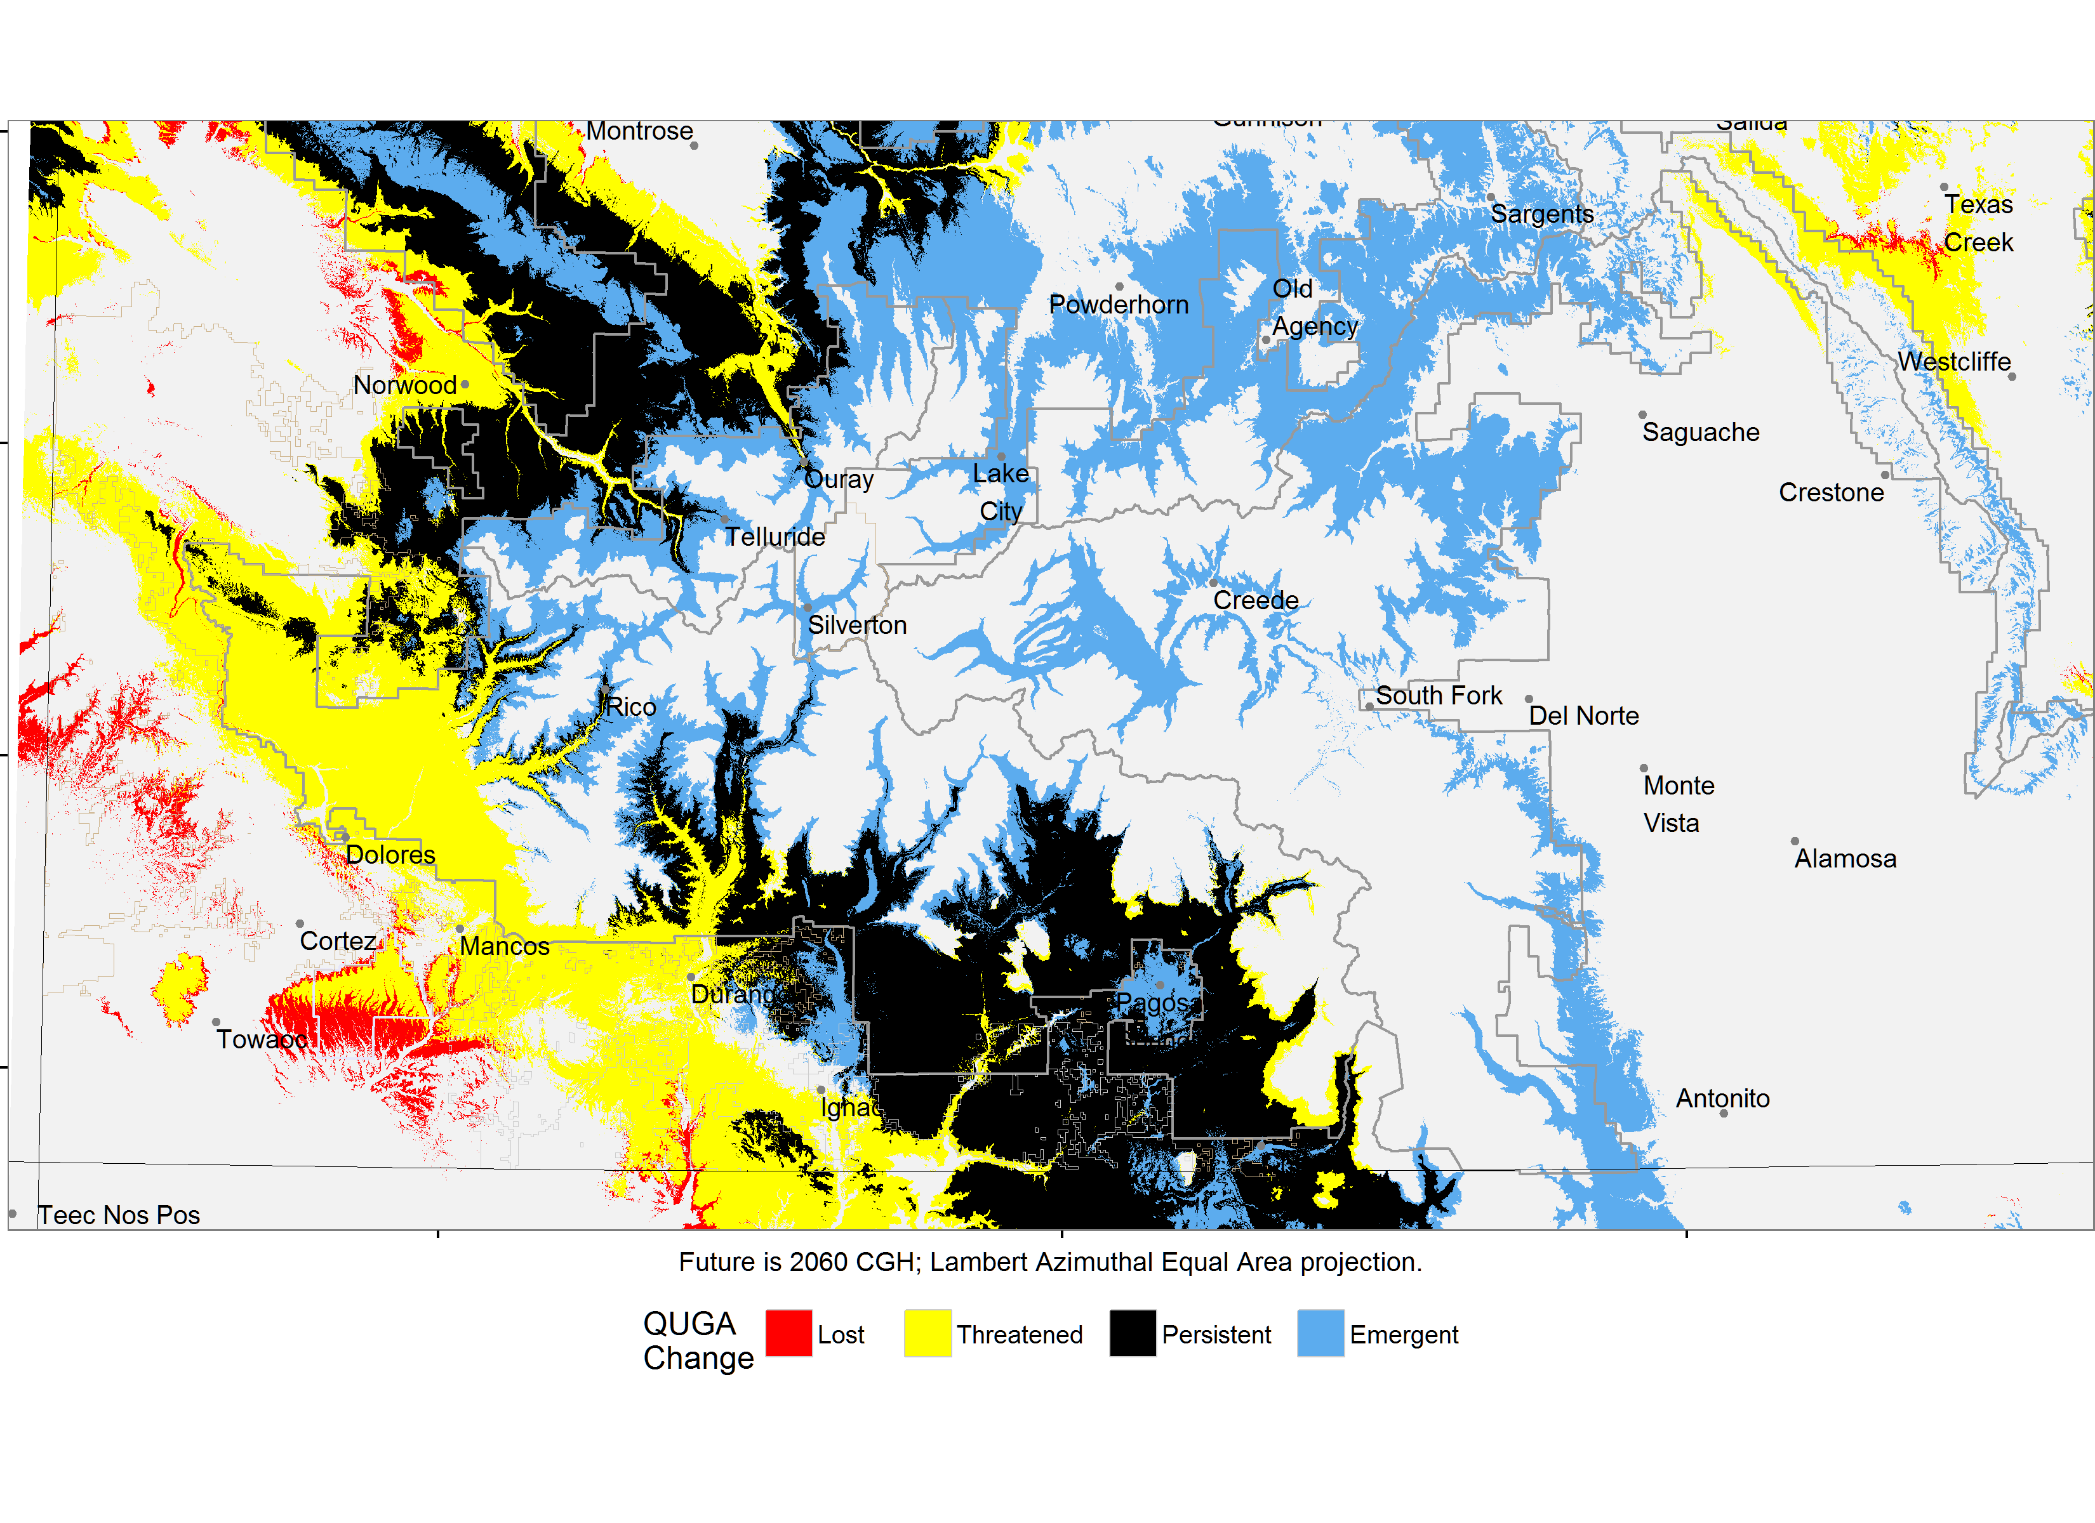
Gambel oak

Slide 30
Conclusions
Recent forest damage can be viewed as early impacts of climate change
If we do not actively manage forest adaptation, ecosystem services will degrade.
Classifying change zones allows us to anticipate change and focus management efforts where they are likely to be most effective

Slide 31
“. . . the future has already arrived.”
— Andreas Hamann

