Slide 1
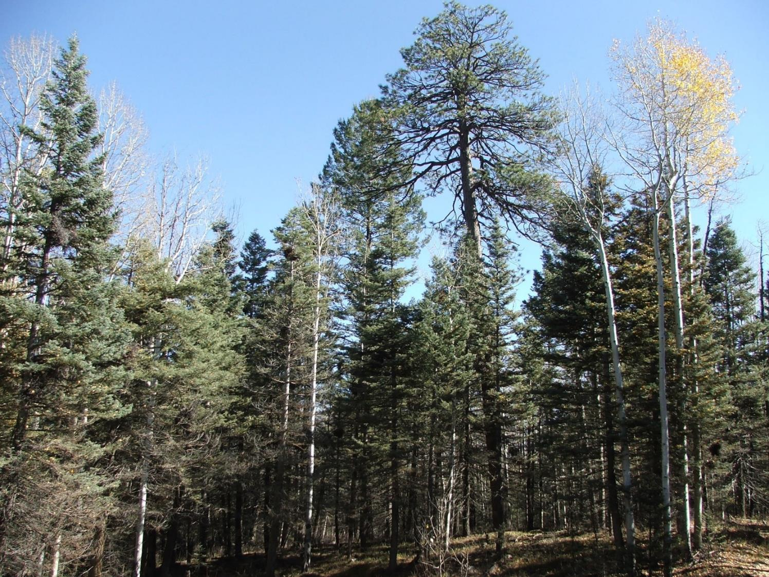



Designing Forest Adaptation Treatments for Climate Change Through Manager-Scientist Partnerships in Southwest CO
Linda Nagel, Mike Battaglia,
Lance Asherin, Molly Roske
September 9-10, 2016

Slide 2

Recent changes in climate for Southwest Colorado
What are we seeing now?
  Warmer temperatures occurring in all seasons
  Warmer temperatures in winter/spring are impacting snowpack totals at lower elevations
  Snowmelt has shifted 2 weeks earlier
Source: Bidwell and Rangwala

Slide 3
Projected temperatures to increase
Source: Bidwell and Rangwala

Slide 4
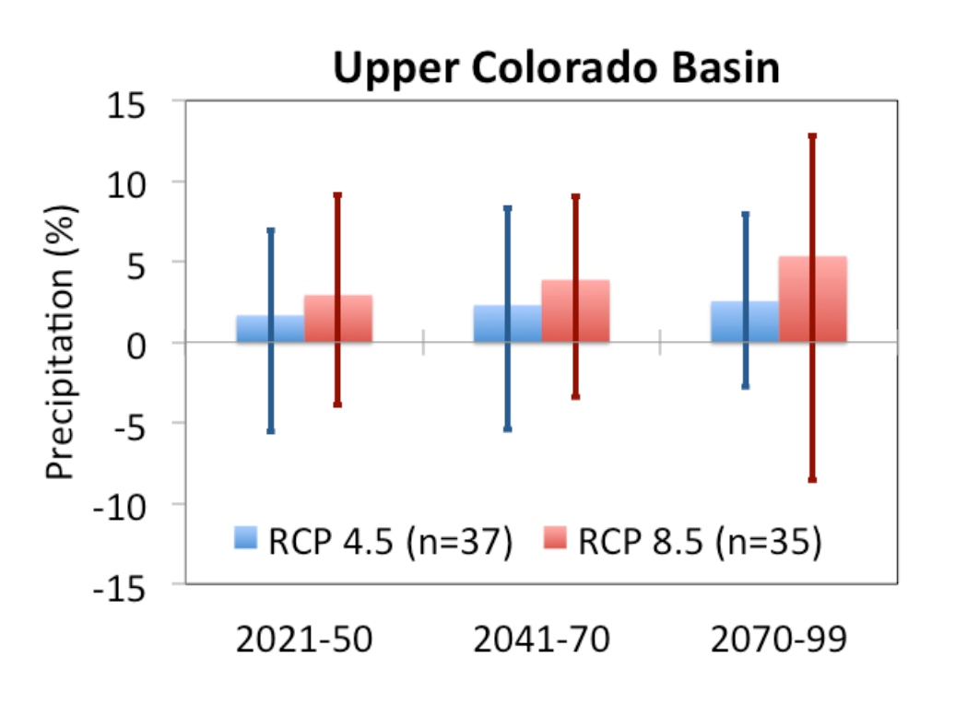
Projected precipitation variable
Source: Bidwell and Rangwala

Slide 5
What actions can be taken to
enhance the ability of a system to cope with change
and
meet goals and objectives?

Slide 6
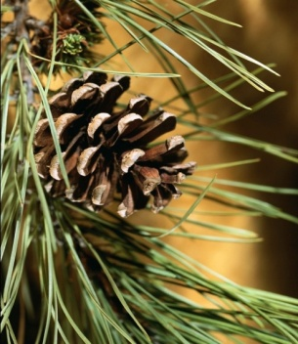
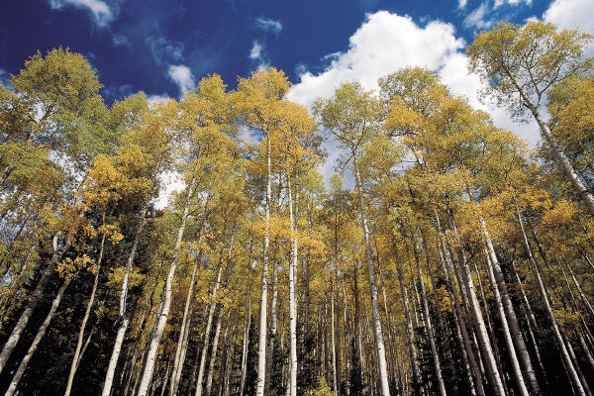
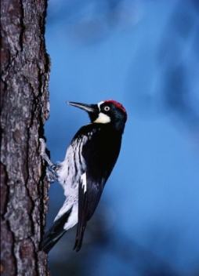
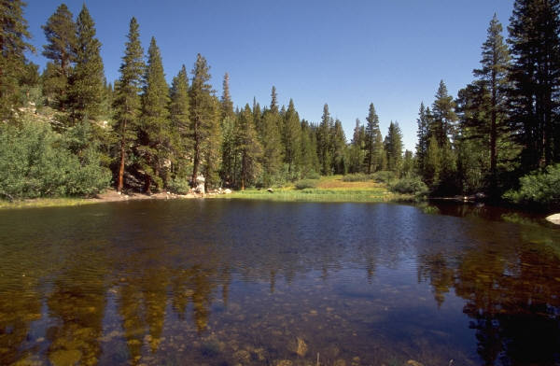
Adaptation is the adjustment of systems in response to climate change.
Ecosystem-based adaptation activities build on sustainable management, conservation, and restoration.

Slide 7
Adaptation is the adjustment of systems in response to climate change.
What do you value?
How much risk are you willing to tolerate?

Slide 8
Uncertainty and Risk
Design actions that are robust across a range of potential future conditions

Slide 9

Climate-Driven Changes
Desired Future Condition
Time

Slide 10
Climate-Driven Changes
Desired Future Condition
Climate Change
Trajectory
?
Time

Slide 11
Adaptation Options
Resistance
Manage for Persistence:
Ecosystems are still recognizable as being the same system (character)
Resilience
Transition
(Response)
Manage for Change:
Ecosystems have fundamentally changed to something different

Slide 12






Adaptive Silviculture for Climate Change Project
ASCC is creating robust, science-based examples of how climate change adaptation can be integrated into forest management planning and on-the-ground actions
Flathead NF/
Coram EF
Chippewa NF/
Cutfoot EF
Second College Grant/
Hubbard Brook EF
WHAT APPROACH BEST PREPARES FOREST ECOSYSTEMS FOR CLIMATE CHANGE?
RESISTANCE – maintain relatively unchanged conditions over time
RESILIENCE – allow some change in current conditions, but encourage eventual return to original conditions
TRANSITION – actively facilitate change to encourage adaptive responses
San Juan NF
J.W. Jones Ecological Research Center
A Collaborative Project Among:
US Forest Service Research and Development (NRS, PNW, PSW, RMRS, SRS)
US Forest Service National Forest System (Chippewa, San Juan, Flathead, White Mountain)
Universities (CSU, UMN, MTU, UMT, UVM, Dartmouth)
Northern Institute of Applied Climate Science
Colorado Forest Restoration Institute
Non-governmental partners
(J.W. Jones Ecological Research Center)

Slide 13
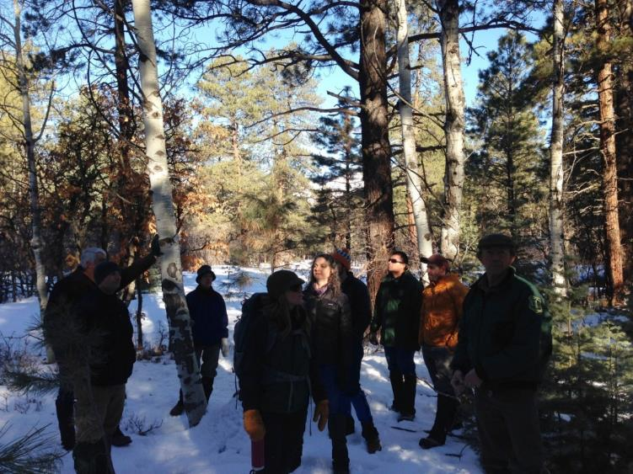
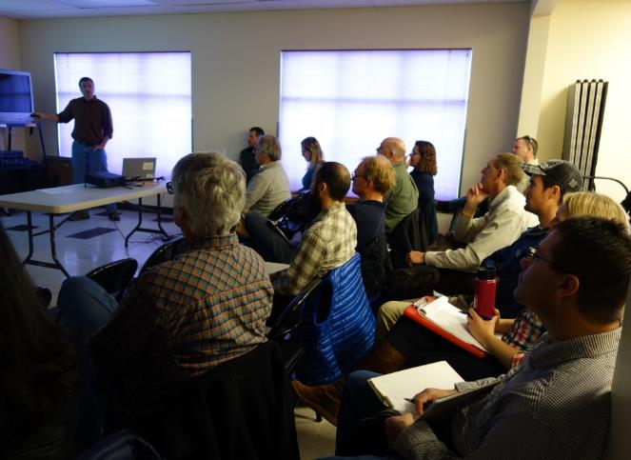
Adaptive Silviculture for Climate Change (ASCC): A National Network
PROJECT GOALS
Populate a multi-region study design with ecosystem-specific climate change adaptation treatments using input from an expert panel of regional scientists and local managers

Slide 14
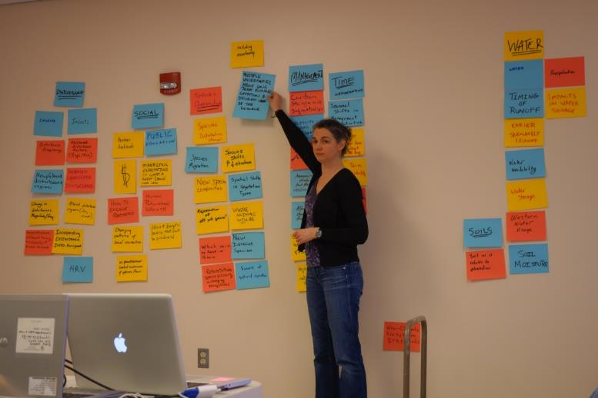
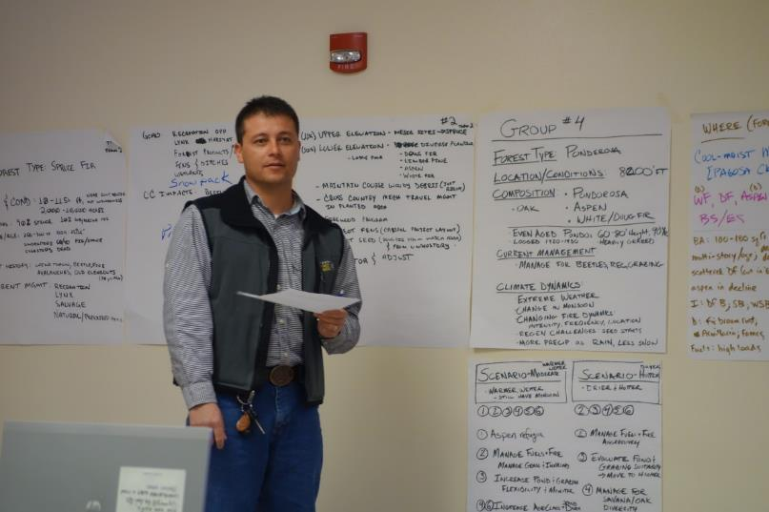
Workshop to develop desired future conditions
March 2014 – Pagosa Springs
Provided participants with information on:
Potential changes in climate
Tree species ecology
Disturbance ecology
Adaptation framework

Slide 15
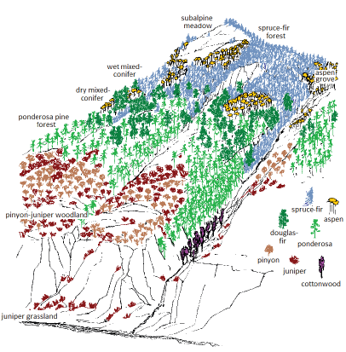
  Warmer
  Earlier snowmelt
  Decrease in snowpack below 2,500 meters
Reynolds et al. 2013

Slide 16
Ponderosa pine (Pinus ponderosa)
Douglas-fir (Pseudotsuga menziesii)
Aspen (Populus tremuloides)
White fir (Abies concolor)
Photo: Steve Hartvigsen, USDA Forest Service
San Juan National Forest

Slide 17
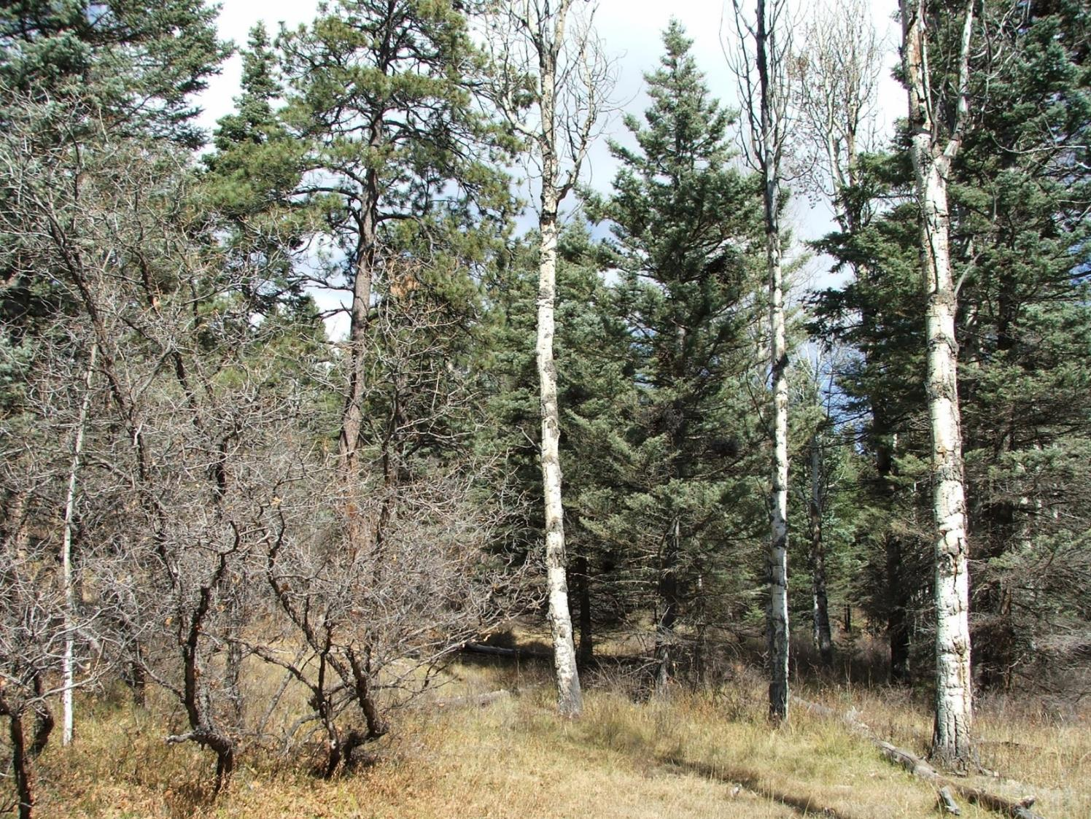
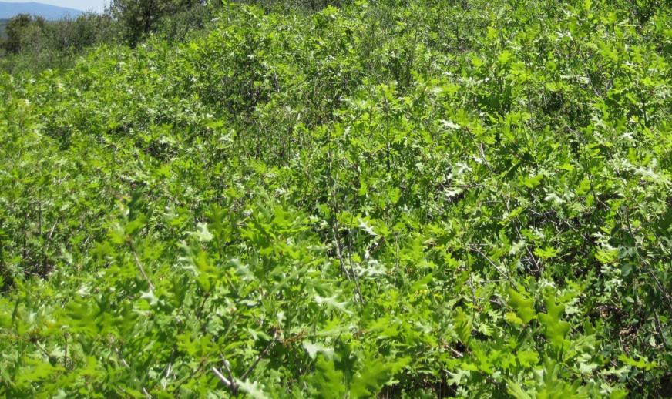
Gambel Oak
(Quercus gambelii)
Photo: Steve Hartvigsen, USDA Forest Service
San Juan National Forest

Slide 18
Shade tolerance
Ponderosa pine
Engelmann spruce
Gambel Oak
Douglas-fir
Blue Spruce
White fir
Subalpine fir
Aspen
Intolerant
Intermediate
Tolerant
Niinemets, U., Vallardes, F., 2006. Tolerance to shade, drought, and waterlogging
of temperate Northern Hemisphere trees and shrubs. Ecol. Monogr.
76, 521–547 (Ecological Archives M076-020-A1).

Slide 19
Heat tolerance
Engelmann spruce
Ponderosa pine
Subalpine fir
Gambel Oak
Blue Spruce
Douglas-fir
White fir
Aspen
Intolerant
Intermediate
Tolerant
Decker, K. and R. Rondeau. 2014. San Juan / Tres Rios Climate Change Ecosystem Vulnerability Assessment. Colorado Natural Heritage Program, Colorado State University, Fort Collins, Colorado.

Slide 20
Drought tolerance
Engelmann spruce
Ponderosa pine
Subalpine fir
Blue Spruce
Gambel Oak
White fir
Douglas-fir
Aspen
Intolerant
Intermediate
Tolerant
Niinemets, U., Vallardes, F., 2006. Tolerance to shade, drought, and waterlogging
of temperate Northern Hemisphere trees and shrubs. Ecol. Monogr.
76, 521–547 (Ecological Archives M076-020-A1).

Slide 21
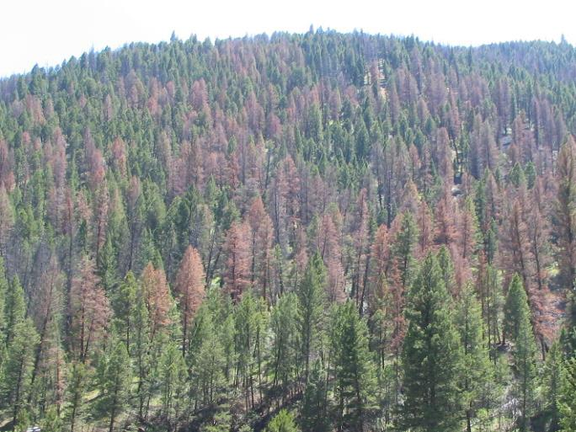
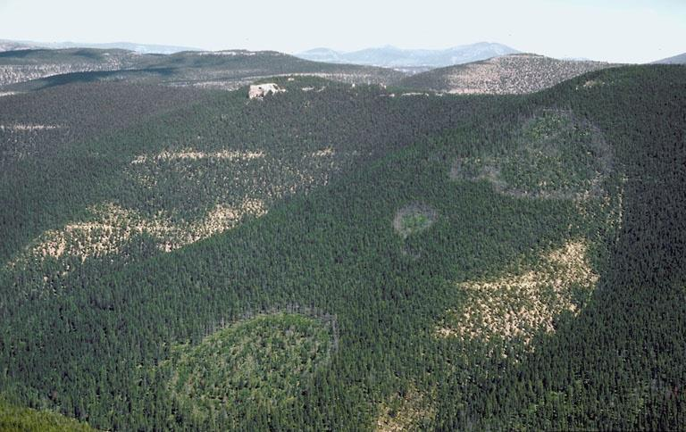
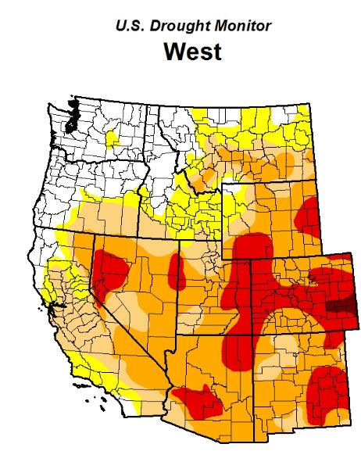
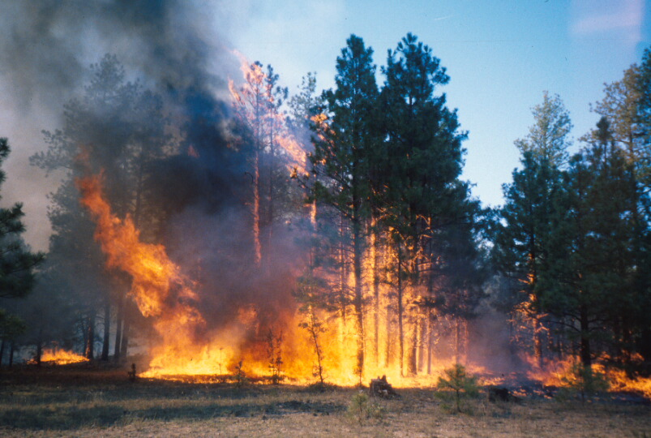
Insects
Needle miners
Western spruce budworm
Douglas-fir tussock moth
Bark beetles
Mountain pine beetle
Fir engraver
Disease
Dwarf mistletoe
Root disease
Fir broom rust
Disturbances
Fire
Drought
Notes:
Sudden aspen decline

Slide 22
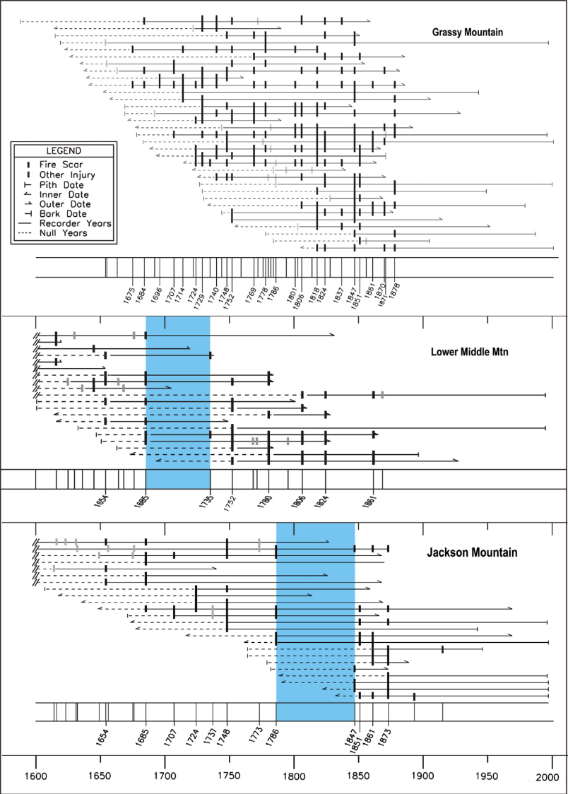
Warm dry mixed conifer forests
Mean Fire Interval = 10 yrs
No Fire free period
Mean Fire Interval = 30 yrs
Fire free period = 50 yrs
Mean Fire Interval = 24 yrs
Fire free period = 61 yrs
Korb et al. 2013
Notes:
Gradient from west to east gradient of ponderosa pine dominated forest… all warm dry mixed confier forests within 50km
Fires used to burn more frequenty, but at different frequencies
There were times with fire free periods but they were much shorter
Different fire histories
Historically, wildfires helped regulate forest structure and fuels
In ponderosa pine forests, fires burned every 3 to 14 years, mostly as surface fires
As you increased in elevation, fire frequency decreased and fire type became more variable
In warm dry mixed conifer forests, fires were every 10 to 36 years and were variable.

Slide 23
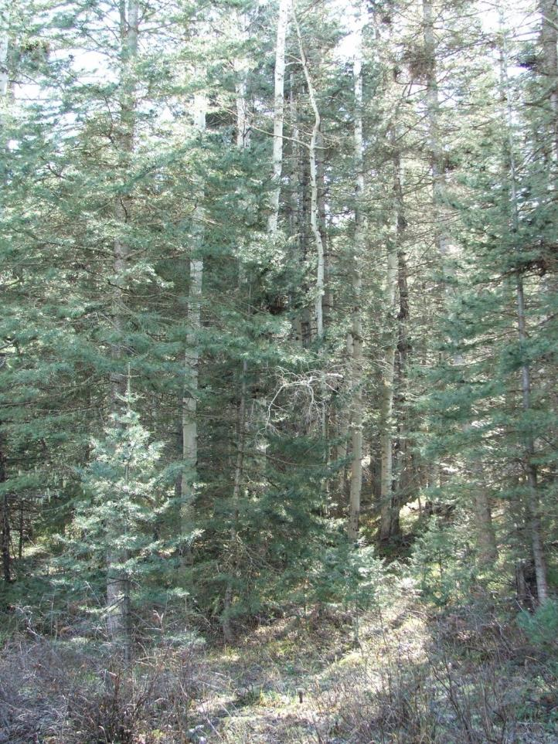
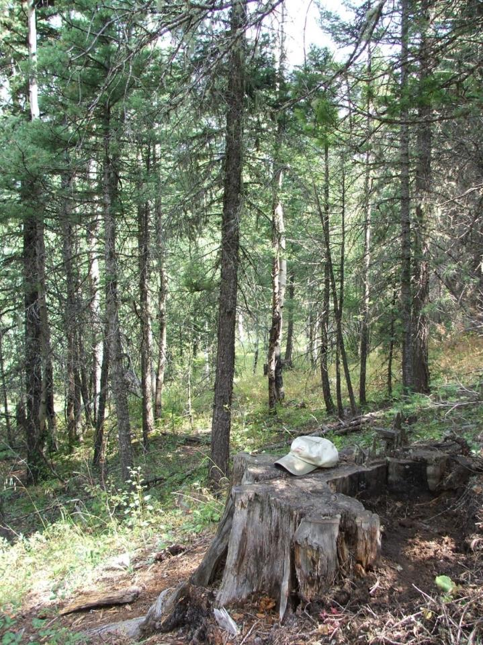
Photos: Steve Hartvigsen, USDA Forest Service, San Juan National Forest
Notes:
Left: Dense white fir
Right: big ponderosa pine tree stump. With fire exclusion, densification of white fir, more trees, and a species shift as logging took out ponderosa pine (stump) and is changing the species composition

Slide 24
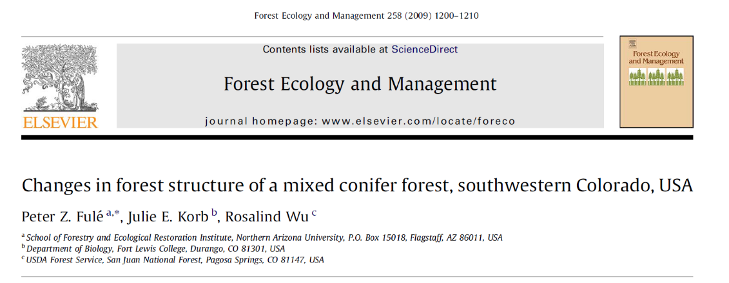
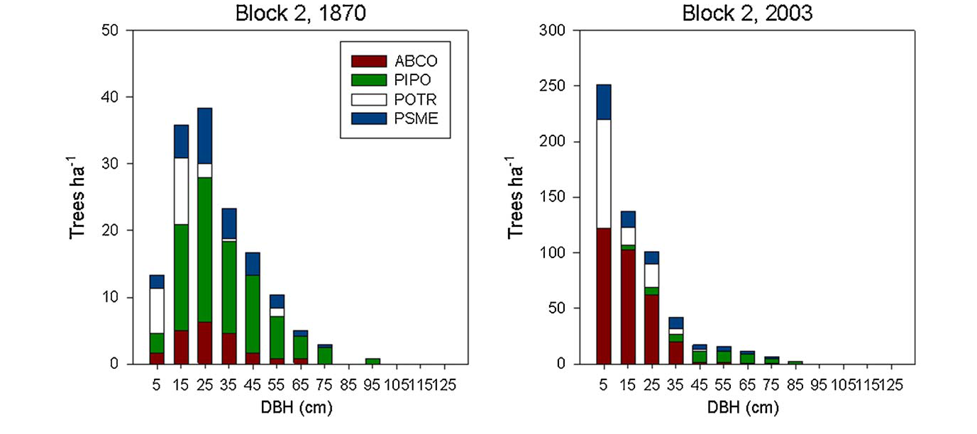
58 ft²/ac
(13.3 m²/ha)
114 ft²/ac (26.1 m²/ha)

Slide 25
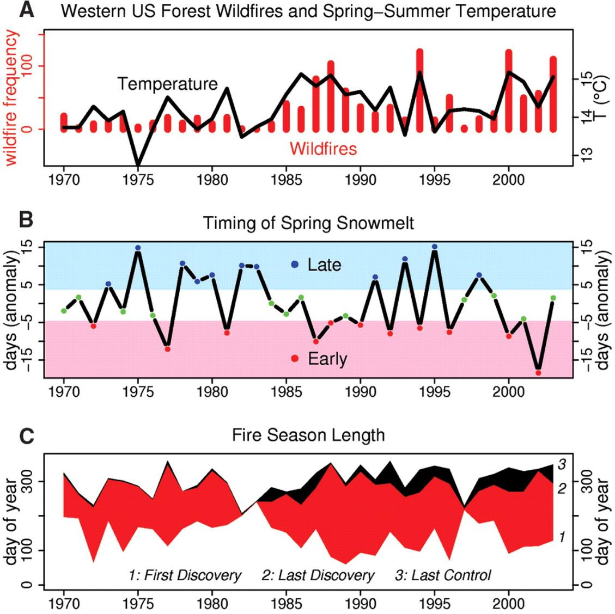
Westerling et al. 2006
Notes:
Currently, we are seeing that with the increase in spring/summer temperatures and earlier snowmelt, that fire season is becoming longer.
This suggests that our forests will be subjected to more fire as climate gets warmer.

Slide 26
Adaptation Options
Promote change
Transition
(Response)
Resilience
Maintain current conditions
Resistance
Reduce climate change impacts
Facilitate adaptive responses
Notes:
The broadest level of adaptation there are three options of resistance, resilience, and transition.
In choosing one of these broad options, we are forming the overall tone of our response to climate change. We’re identifying our level of acceptable change in the forest, from essentially none, to a complete makeover, And we are identifying our means, from a defensive standpoint, to actively facilitating change. depending on the expected magnitude of impacts and resources available.
Under these broad options, there are limitless possibilities for adaptation actions.

Slide 27
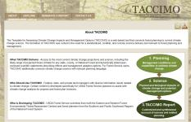
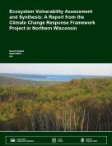
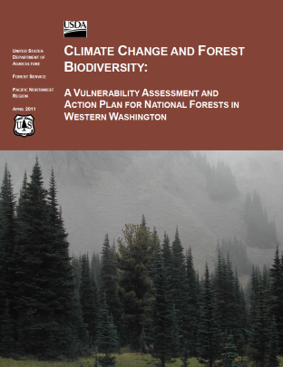
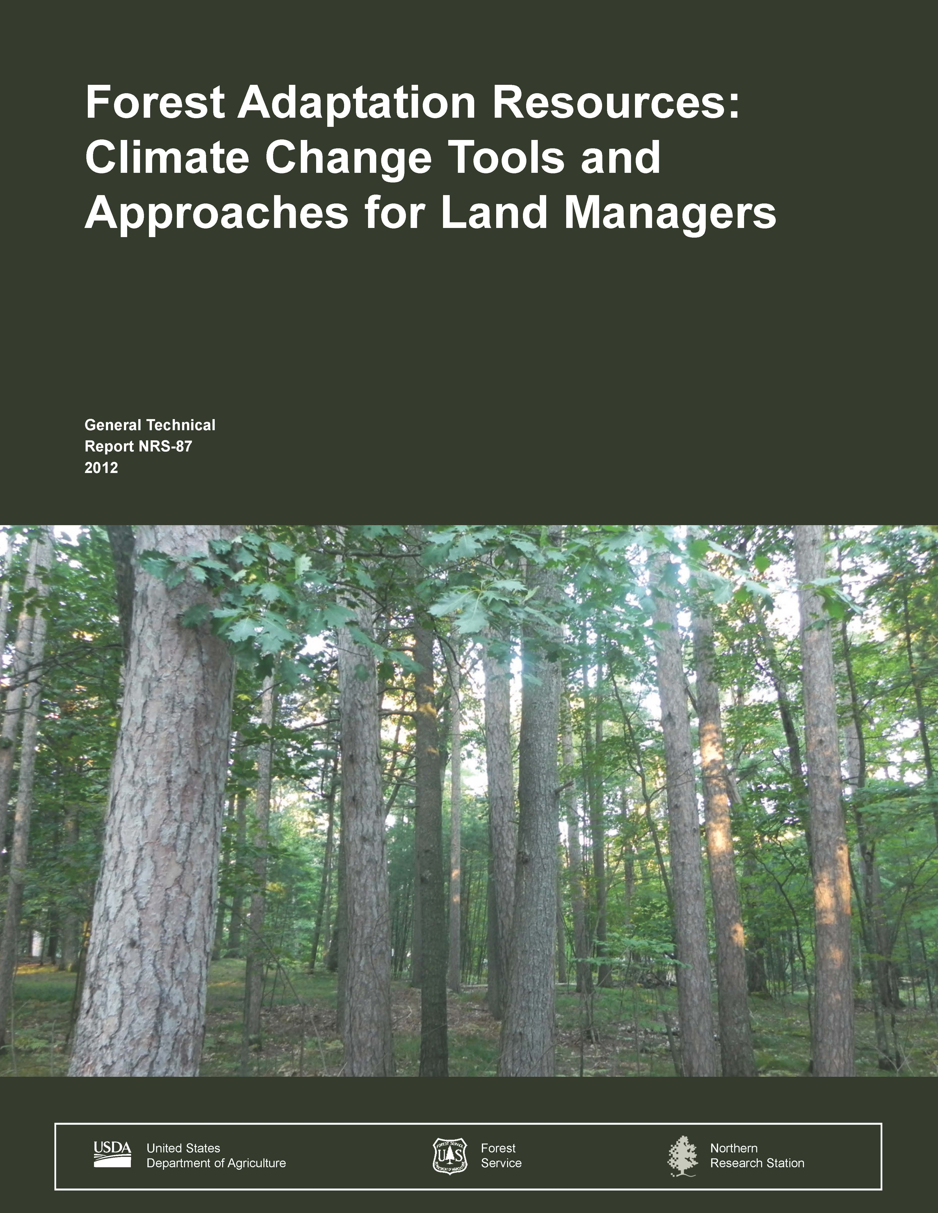
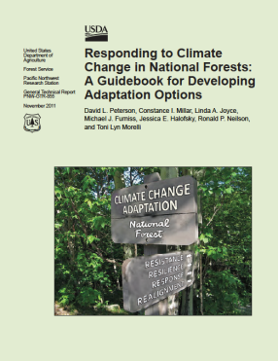
Identifying Adaptation Tactics
1. DEFINE area of interest, management objectives, and time frames.
Vulnerability assessments, scientific literature, and other resources
5. MONITOR and evaluate effectiveness of implemented actions.
2. ASSESS climate change impacts and vulnerabilities for the area of interest.
Adaptation Strategies and Approaches
4. IDENTIFY and implement adaptation approaches and tactics.
3. EVALUATE management objectives given projected impacts and vulnerabilities.
Swanston and Janowiak 2012: www.treesearch.fs.fed.us/pubs/40543, Janowiak et al. 2014

Slide 29
What we think we know…
Warmer, drier conditions in the future
Seasonality of precipitation and earlier snowmelt will affect hydrology and plant response
More fire
More insects and disease
Forests are more susceptible (drought, I/D, fire) at high densities

Slide 30
Resistance Treatment
Maintain relatively unchanged conditions
DFC/Goal
Maintain current proportions of Ponderosa (PP), Douglas-fir (DF), White Fir (WF), Aspen (AS)
Basal area range: 57 to 78 ft²/ac
Tactics
Reduce BA by 40-60% by thinning
Retain priority PP>DF>WF
Keep large PP/DF, old PP/DF/WF
Even spacing

Slide 31
Resilience Treatment
Allow some change, eventual return to reference
DFC/Goal
Increase drought-tolerant species
Relative densities: 45-75% PP, 5-35% DF, 0-15% AS, 0-10% WF
Clumpy, multi-cohort structure
Basal area range: 57 to 78 ft²/ac (range: 0 to 122)
Tactics
Reduce BA by 40-60% by thinning
Favor priority PP>DF>WF
Create openings up to 1 ac
Leave legacy groups, clumps

Slide 32
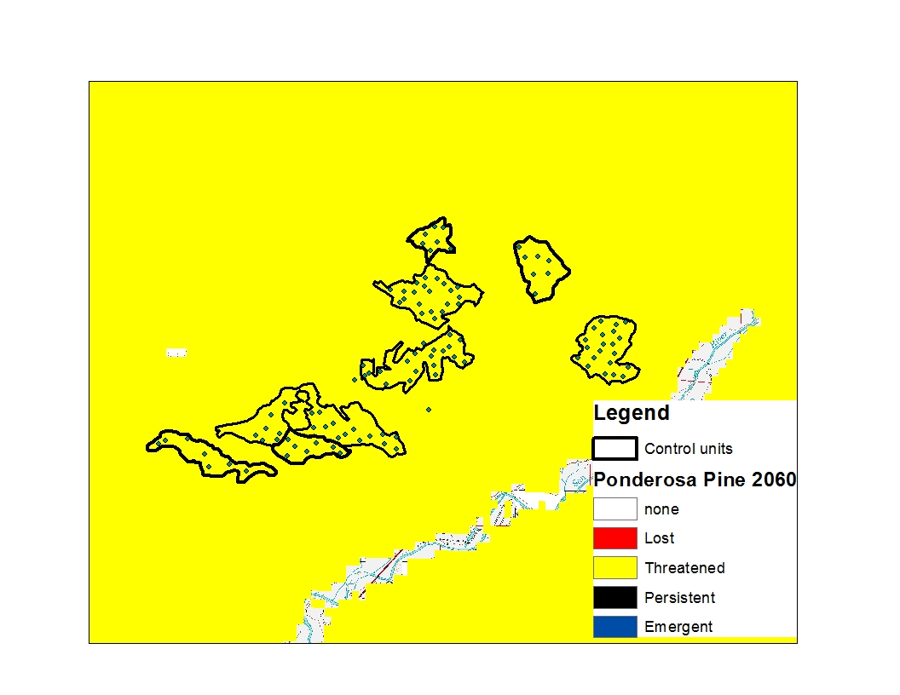
Ponderosa Pine 2060

Slide 33
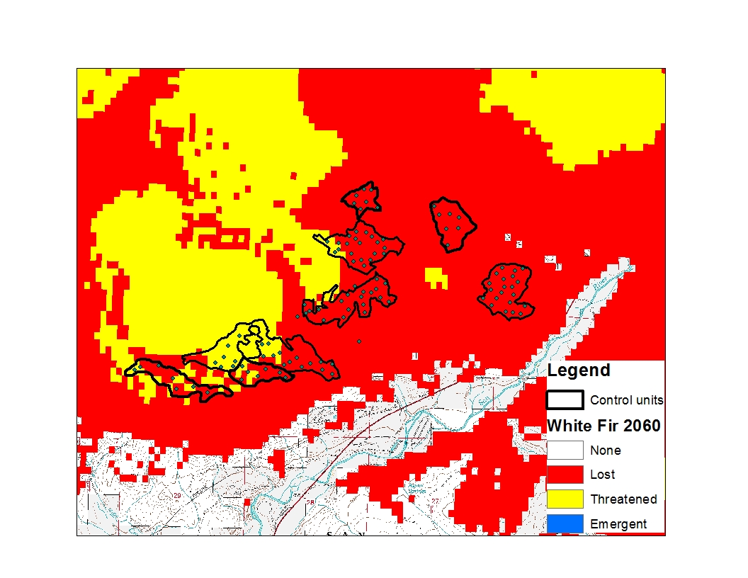
White Fir 2060

Slide 34
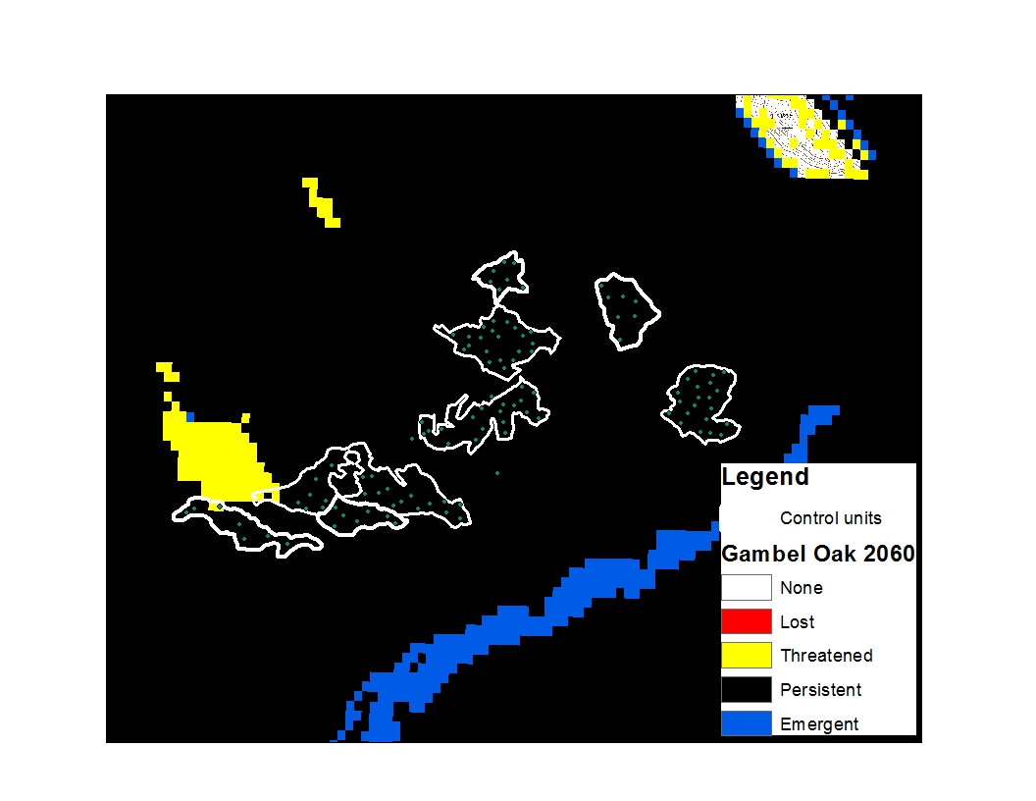
Gambel Oak 2060

Slide 35
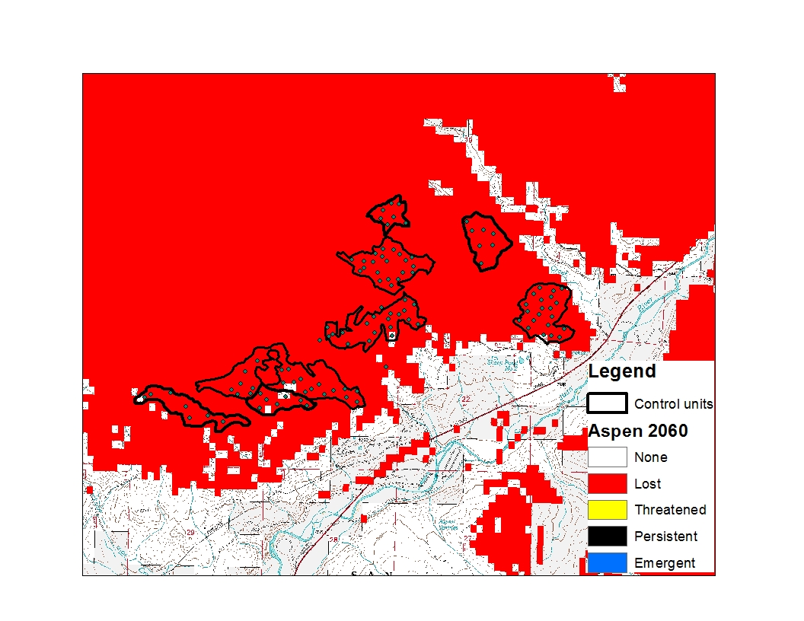
Aspen 2060

Slide 36
Transition Treatment
Actively facilitate change to encourage adaptive responses
DFC/Goal
Increase drought-tolerant species
Increase PP, allow Gambel Oak and Juniper to increase
Open canopy ~ 40 ft²/ac (range 0 to 78)
Tactics
Retain PP, AS (N slopes, swales)
Remove all WF
Canopy openness target of 30-40%
Enhance current openings
Increase shrubs for big-game winter range

Slide 37
Variable densities
ALL TREATMENTS
Rx burn every 5-10 years
Rx burn to raise canopy height and reduce ladder fuels (0 to 5 inch size class)
Grouped trees with predominance of openings

Slide 38
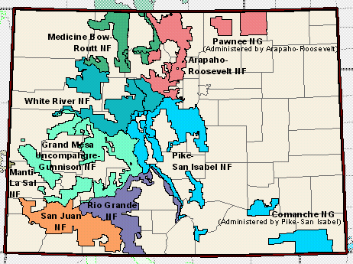
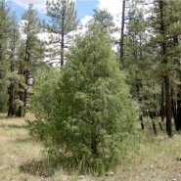
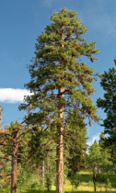
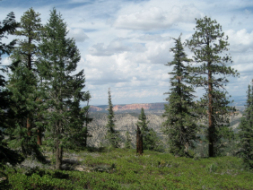
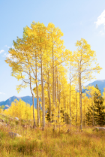
San Juan National Forest
Spectrum of Adaptive Forest Management Treatments
Promote Change
Transition
Management Goal: intentionally accommodate change and enable ecosystems to adaptively respond to changing conditions
Strategy: Environment dominated by openings, retain PP and DF in clumps, Aspen in swales and N slopes, remove all WF
Resilience
Management Goal: allow some change in current conditions, but encourage a return to reference conditions
Strategy: variable tree cover and openings (up to 1 ac), increase drought-tolerant species
Species:
ponderosa pine ⬆
Douglas-fir ⬆
white fir ⬇
aspen in clumps
grass/shrub/oak/RMJ/Pinyon pine ⬆
Maintain current conditions
Resistance
Species:
ponderosa pine ⬆
Douglas-fir ⬆
white fir ⬇
aspen in clumps
Management Goal:
maintain relatively unchanged conditions over time
Strategy: maintain proportional PP, DF, WF, AS
Reduce climate change impacts
Facilitate adaptive responses

Slide 39
Next Steps
Stands are marked for harvest
Pre-treatment data collection
Harvests to be implemented in Fall 2018 -?
Post-treatment measurements in Summer 2019

Slide 40
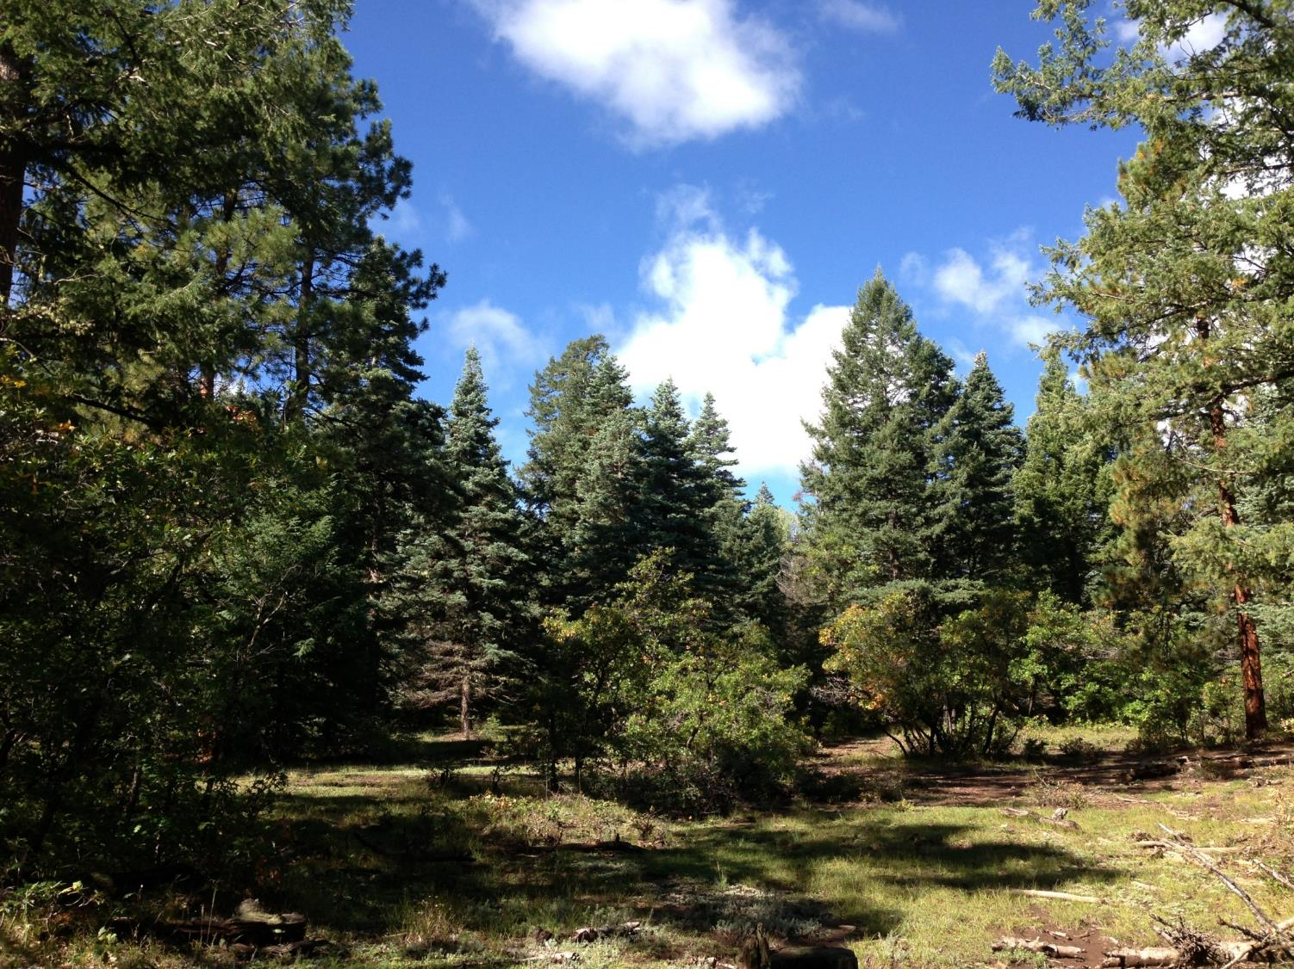
Acknowledgements
San Juan NF – Steve Hartvigsen, Gretchen Fitzgerald, Matt Tuten, Tim Leishman
Questions?
linda.nagel@colostate.edu
mbattaglia@fs.fed.us

Slide 42
Fire resilient species
Ponderosa pine
  Thick Bark, open crown, tall crown base height, large buds
  Seedlings are susceptible
Douglas-fir
  Older trees with thick bark increase resiliency
  Short crown base height, dense foliage decrease resiliency
  Seedling and saplings are susceptible
White fir
  Older trees with thick bark increase resiliency
  Short crown base height, dense foliage decrease resiliency
  Seedling, saplings, and poles are susceptible
Notes:
So integrating our knowledge of tree species susceptibility to fire is important.
Ponderosa pine, good resilience of fire due to its thick bark, open crown, tall crowns, and large buds.. However, seedlings are susceptible
Douglas-fir, older trees are resilient, but the crown structure of this species does increase its susceptibility
Seedling and saplings are susceptible

Slide 43
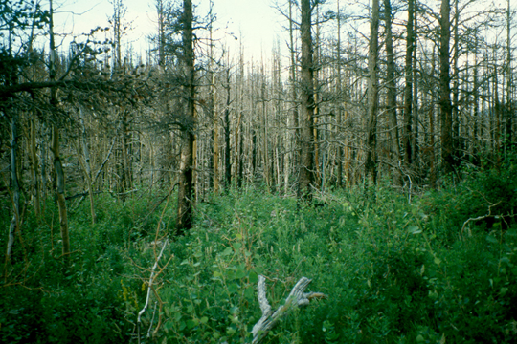
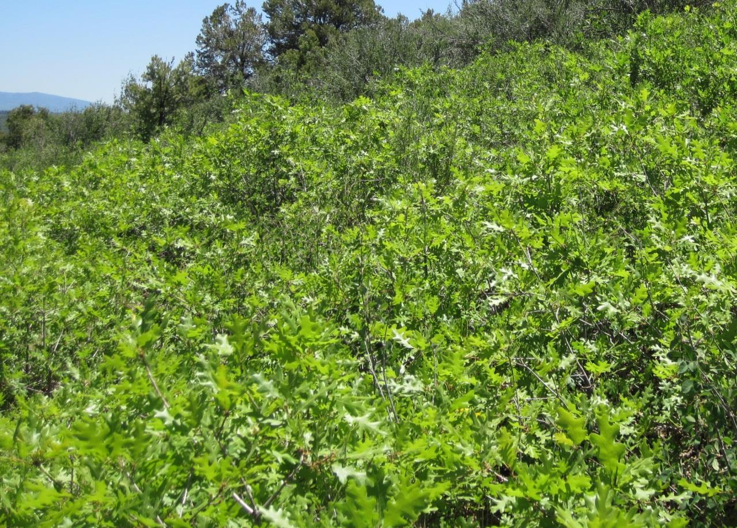
SPROUTERS
Aspen
Medium bark and low/medium resistance to fire, but RESPROUTS
Gambel oak
Thin bark and low resistance to fire, but RESPROUTS
Notes:
Aspen is often killed by fire, but has the ability to sprout back
Same with Gambel Oak

Slide 44
Modification to the MPB
Susceptibility Rating
In 1994, Schmid and others suggested:
  High hazard stand: >120 ft²/acre
  Moderate hazard: 80 to 120 ft²/acre
  Low hazard: <80 ft²/acre
Schmid and others (2007) now suggest:
  High hazard stand: >100 ft²/acre
  Low hazard: <80 ft²/acre

Slide 45
Lower density ponderosa pine forests are less sensitive to drought
Relative Density
Bottero et. al. (in review)
Notes:
2002 dry years
Drought resilience

Slide 46
Adaptive Silviculture for Climate Change (ASCC): A National Network
PROJECT JUSTIFICATION
Forest managers need robust, operational examples of how to integrate climate change adaptation into silvicultural planning and on-the-ground actions that can…
  Foster resilience to the impacts of climate change
  Enable adaptation to uncertain futures

Slide 47
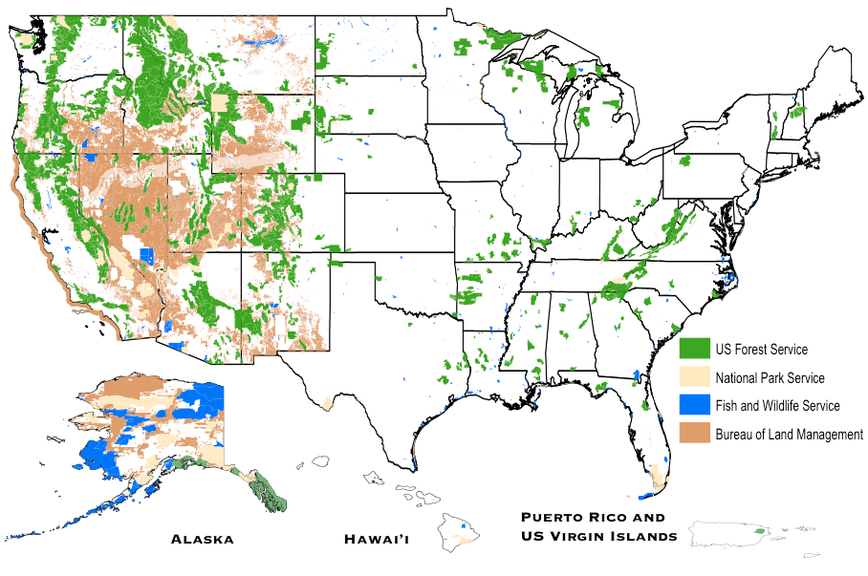
Adaptive Silviculture for Climate Change (ASCC)
NRS/NIACS:
Chris Swanston
Maria Janowiak
PIs
PNW: Dave Peterson
SITE 4: Coram EF on Flathead NF
Site Leads: Elaine Sutherland & Terrie Jain
NRS: Brian Palik
Collaborators
SITE 1: Cutfoot EF on Chippewa NF
Site Lead: B Palik
Study Sites
OSU: Lisa Ganio
SITE 5: Second College Grant (Dartmouth) & Hubbard Brook EF
Site Leads: Tony D’Amato & Chris Woodall
PI: Linda Nagel, CSU
RMRS: Linda Joyce
PSW: Connie Millar
SITE 2: San Juan NF
Site Lead: Mike Battaglia
SRS: Jim Guldin (PI)
SITE 3: Jones Ecological Ctr
Site Lead: Steve Jack
3/27/16

Slide 48
Adaptive Silviculture for Climate Change (ASCC): A National Network
PROJECT GOALS
Compare key variables among 4 adaptation treatments in 5 different forest types across the United States
    Forest growth and productivity
    Overstory and understory species composition
    Forest health and/or tree vigor
Treatments
Resistance
Resilience
Transition
No Action
Sensu Millar et al 2007

